Slide 1
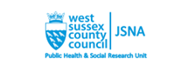
Health and Wellbeing in Adur & Worthing
Plus Cost of Living Data Update
Don’t worry won’t be doing all the slides!
Jacqueline.clay@westsussex.gov.uk
Manager, West Sussex Public Health and Social Research Unit

Slide 2

Notes:
I am going to start at a West Sussex level. Looking at some basic data from the GBD

Slide 3
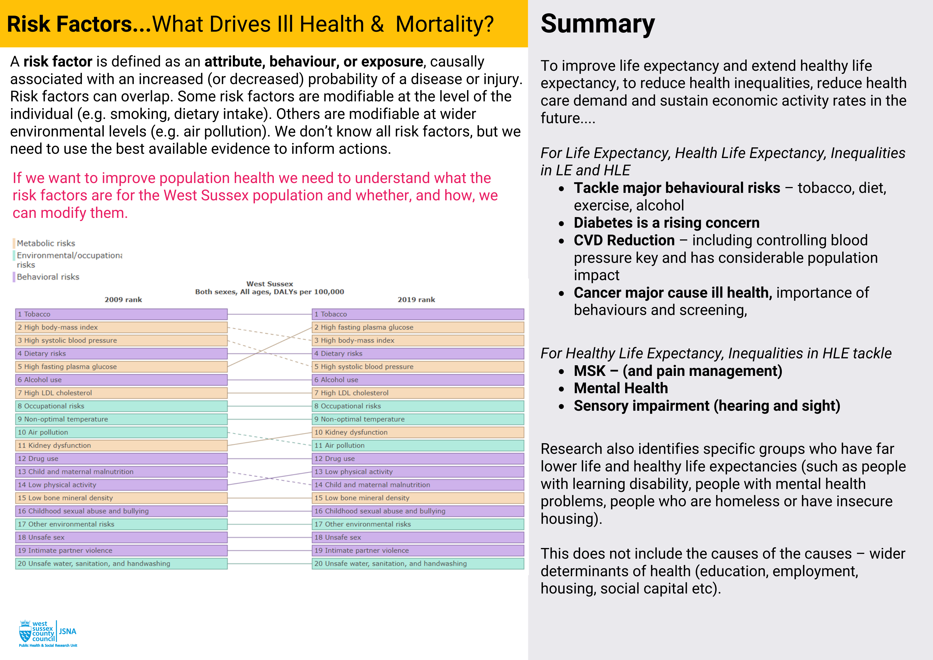
Notes:
In addition to causes

Slide 4
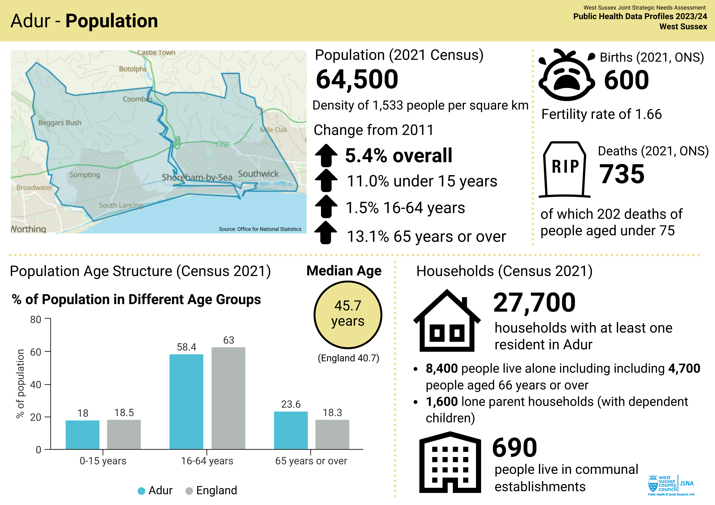

Slide 5
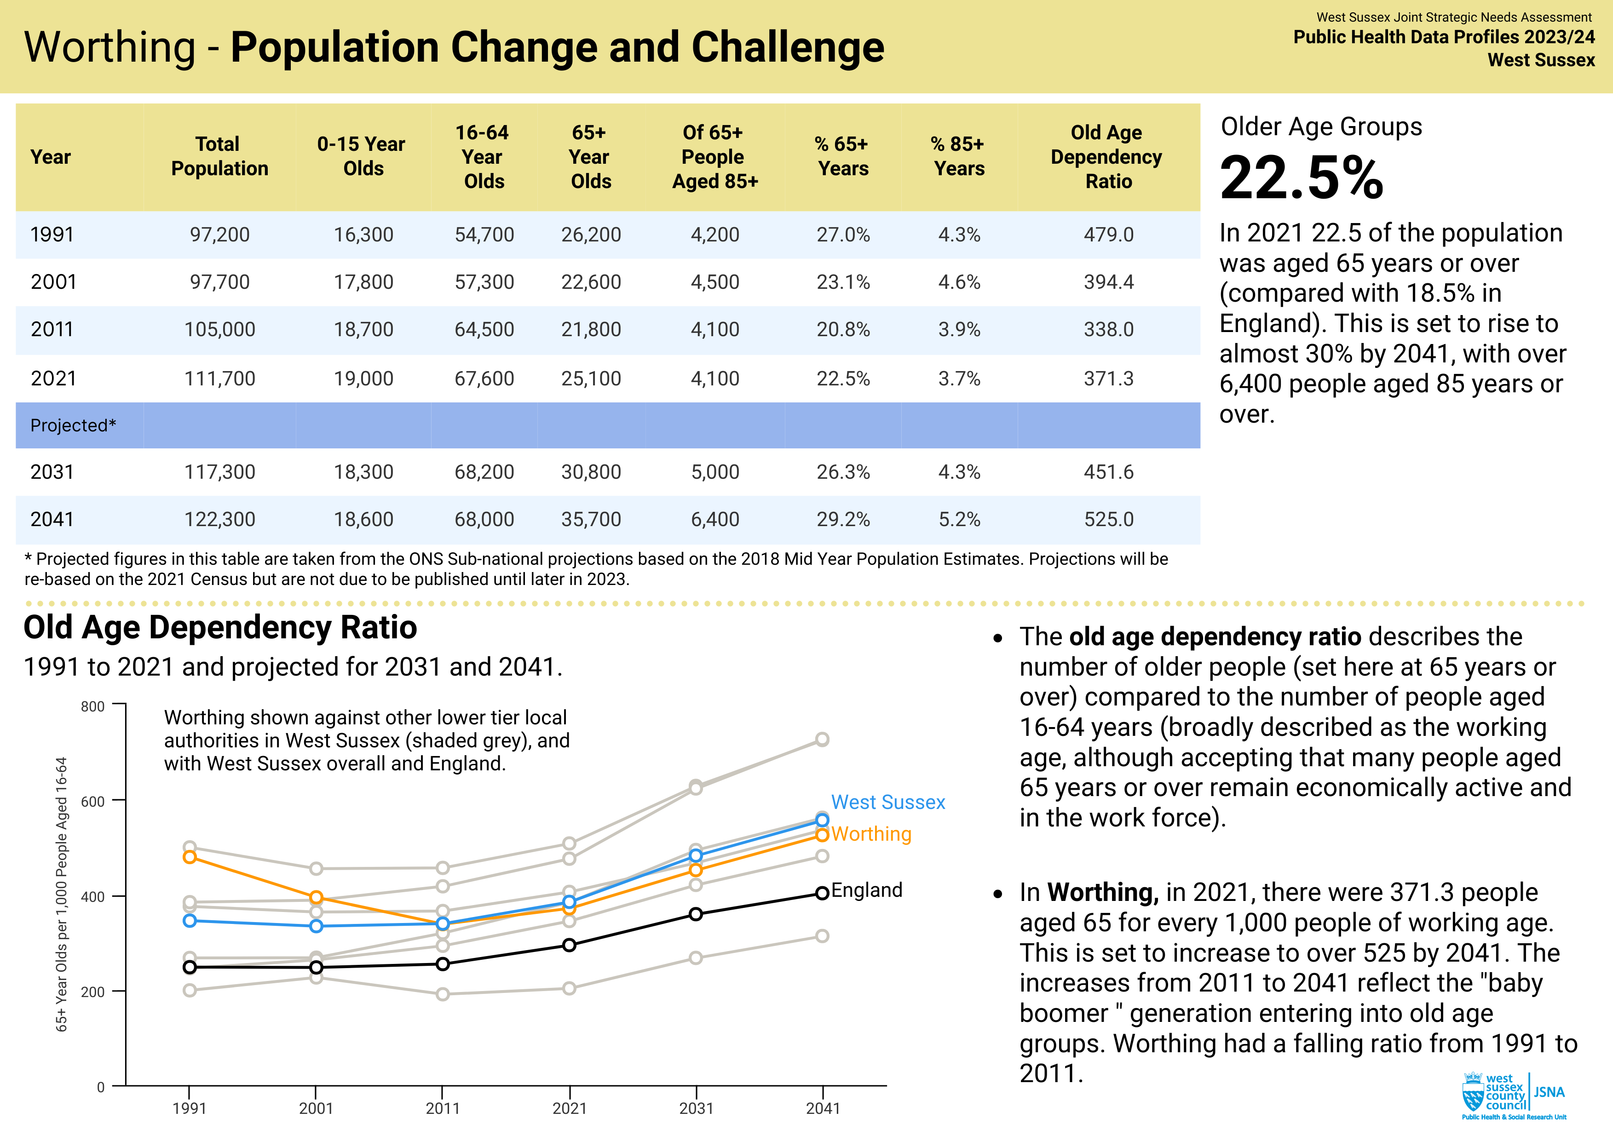

Slide 6
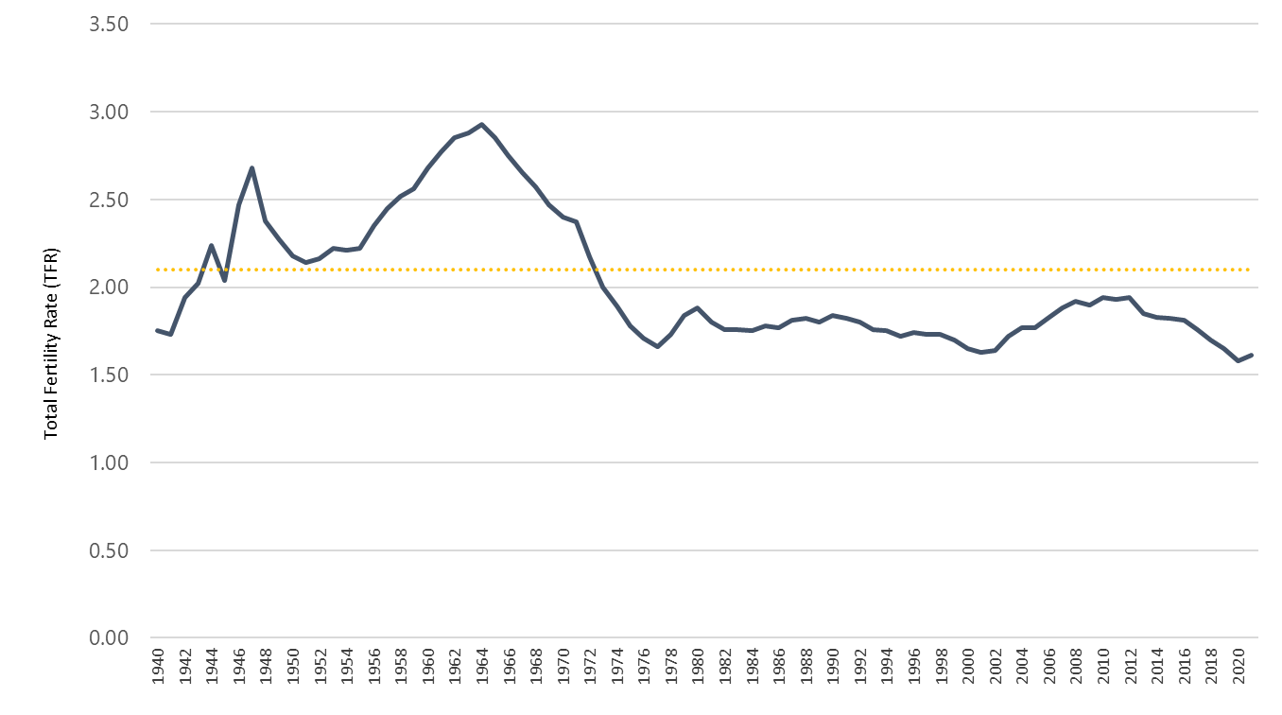
Population Change – Key Driver
Total Period Fertility Rate – England and Wales 1940-2020
Impact already in the system, period of 2021 to 2031 will see steep increases in 65+
Two distinct peaks, immediate post war II boom, people now entering late their 70s, 80s, then people born in late 1950s to mid 60s, will be entering 65+ group in next 5-10 years

Slide 7
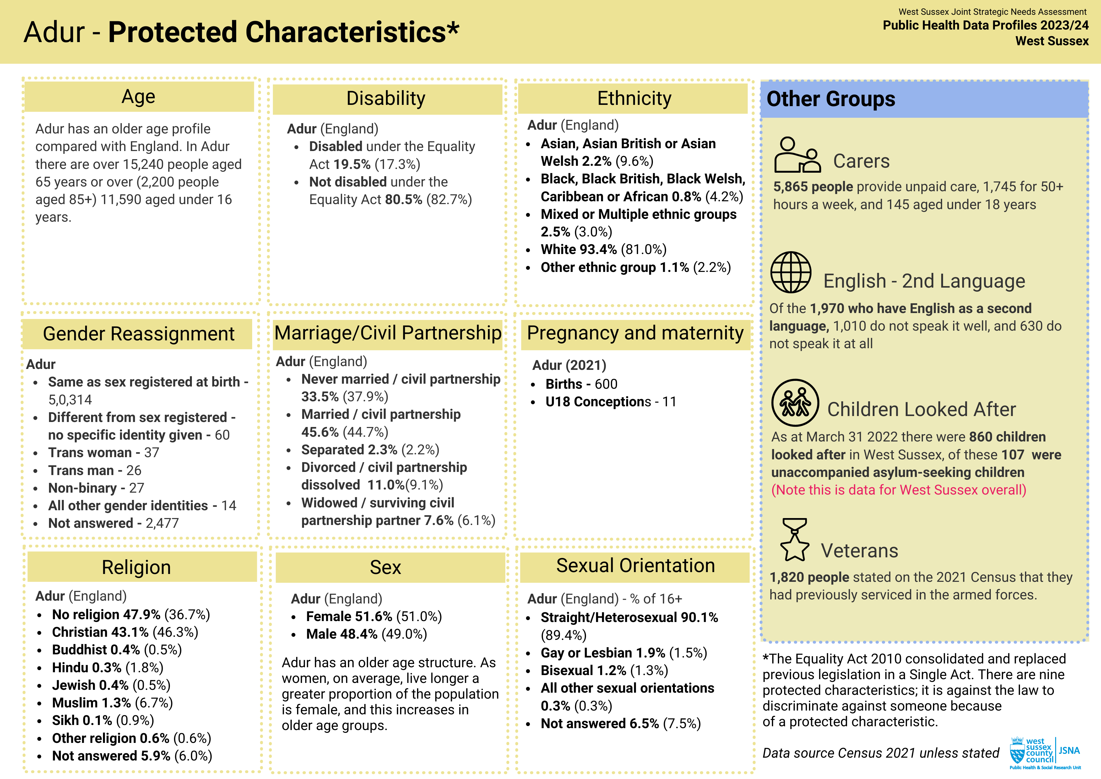

Slide 8
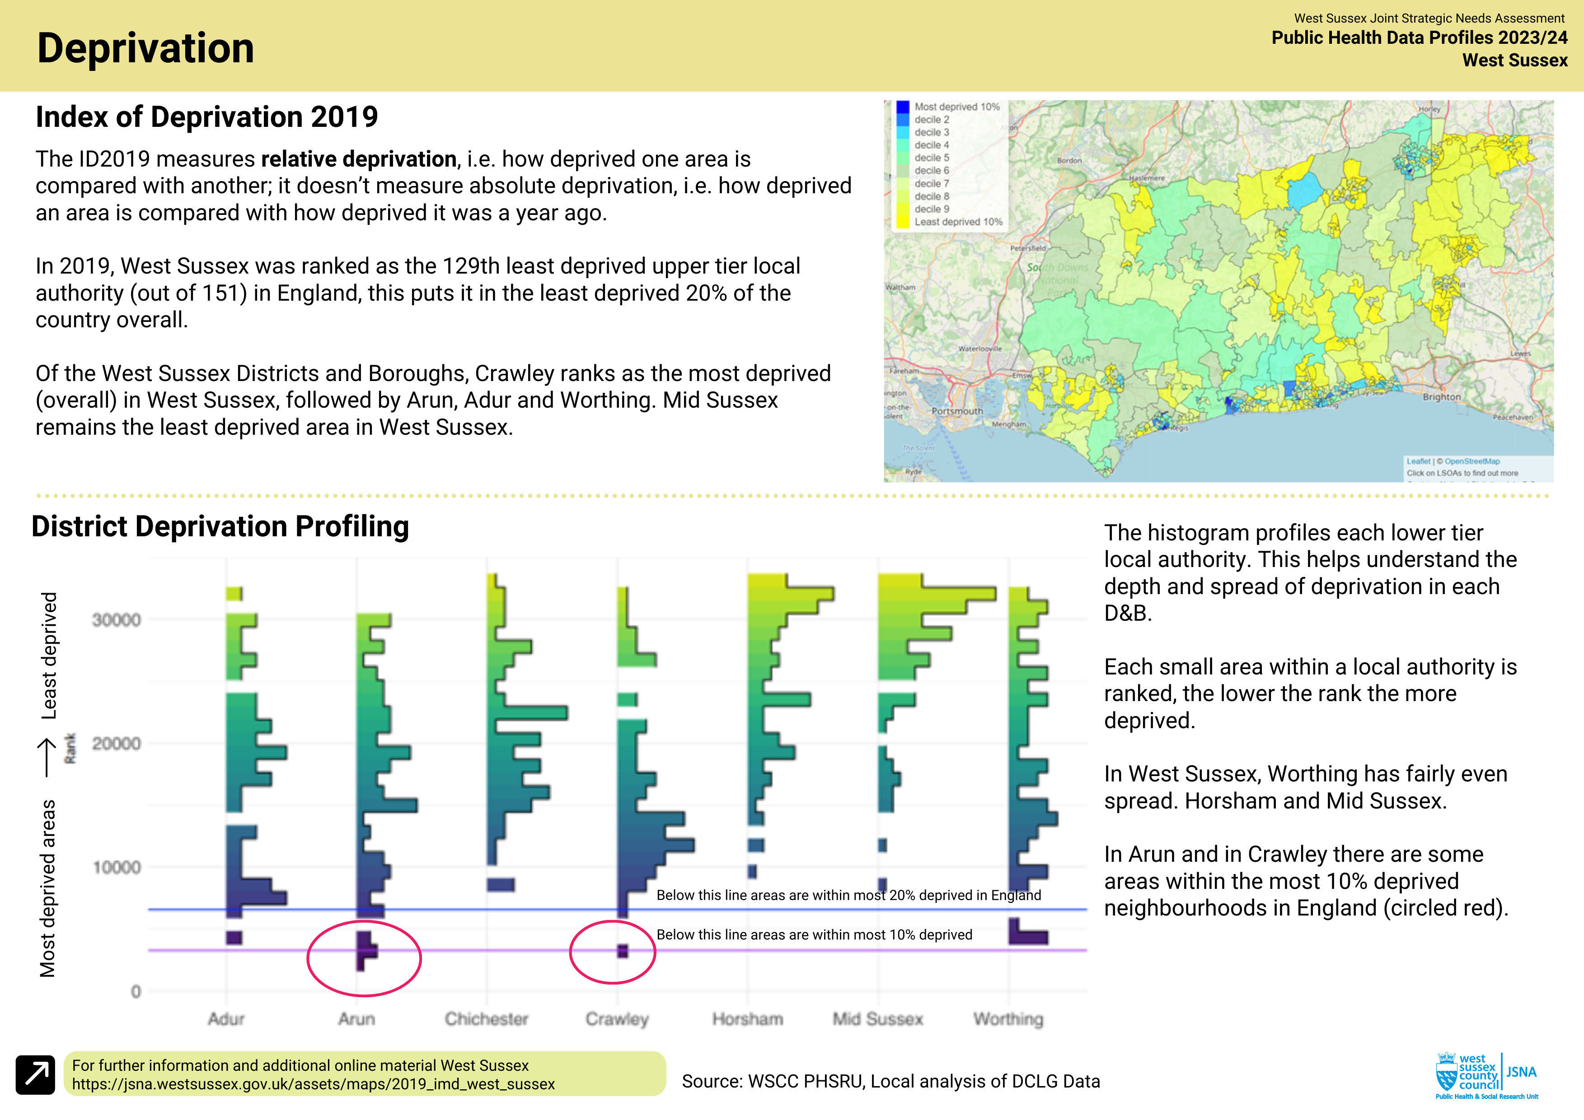

Slide 9
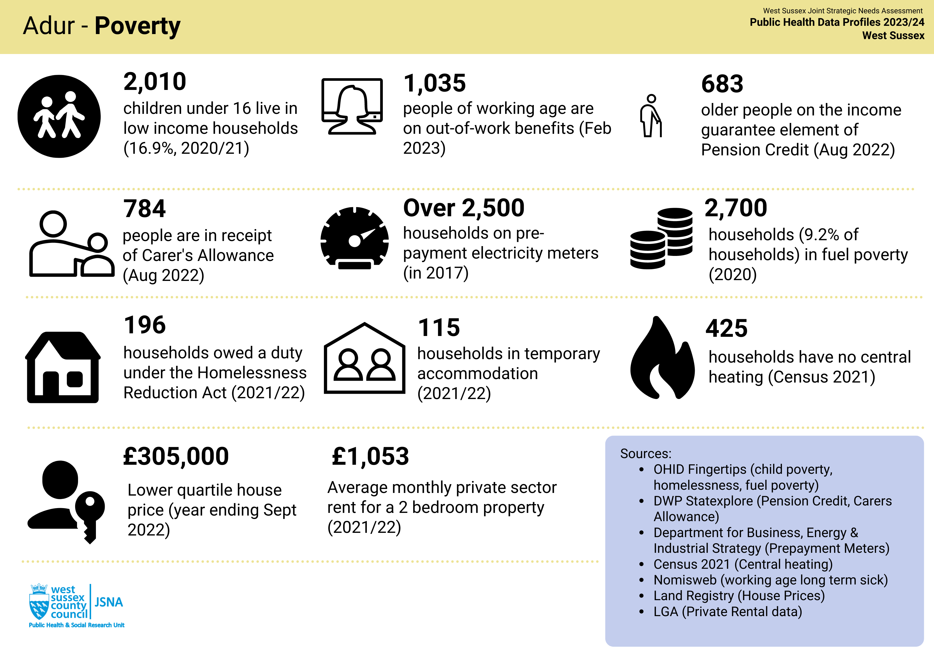

Slide 10
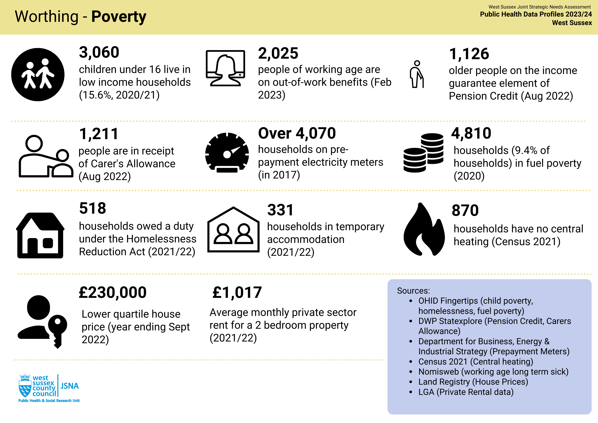

Slide 11
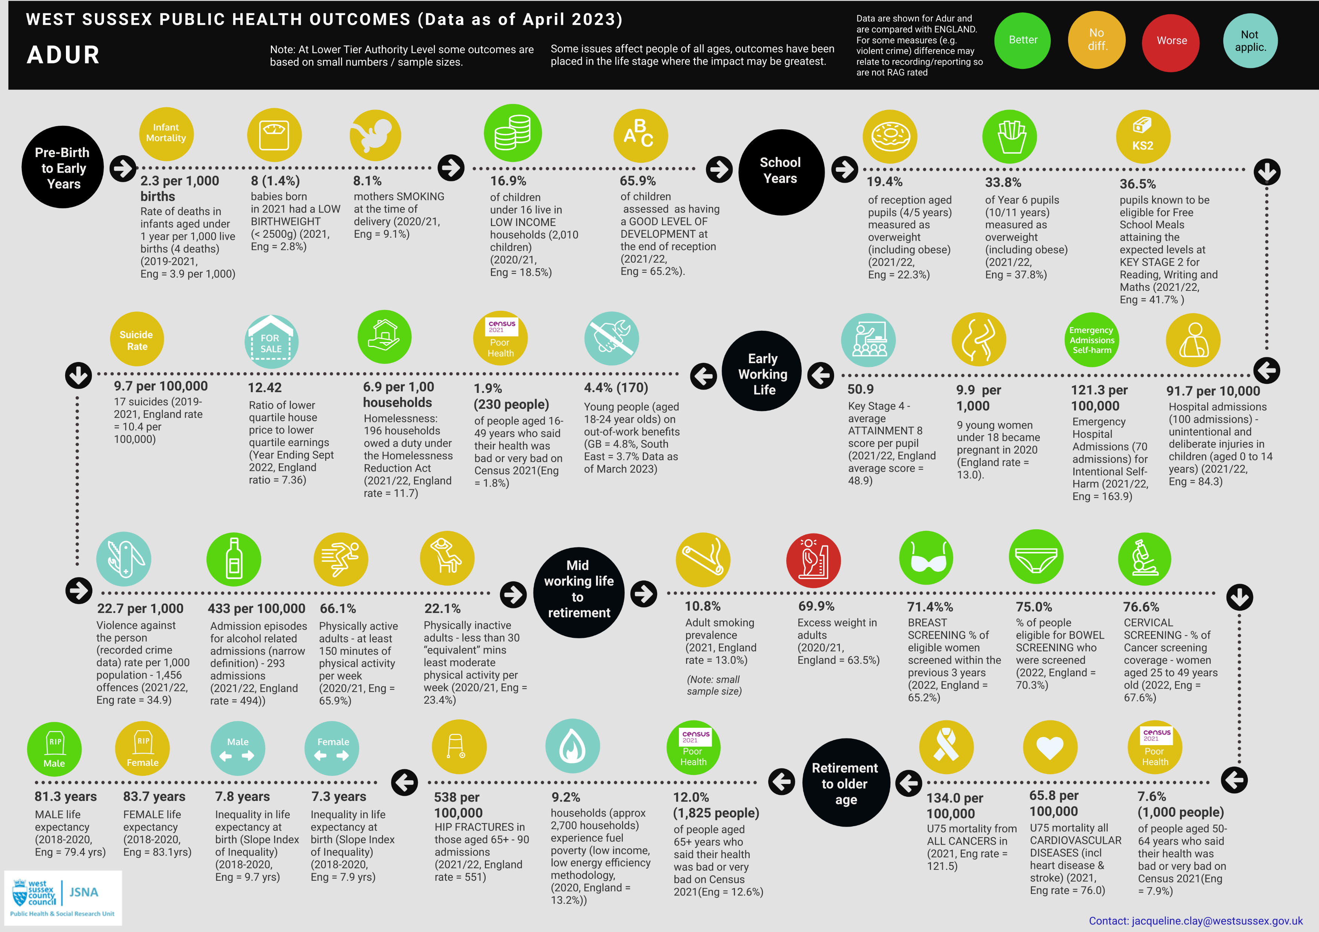

Slide 12
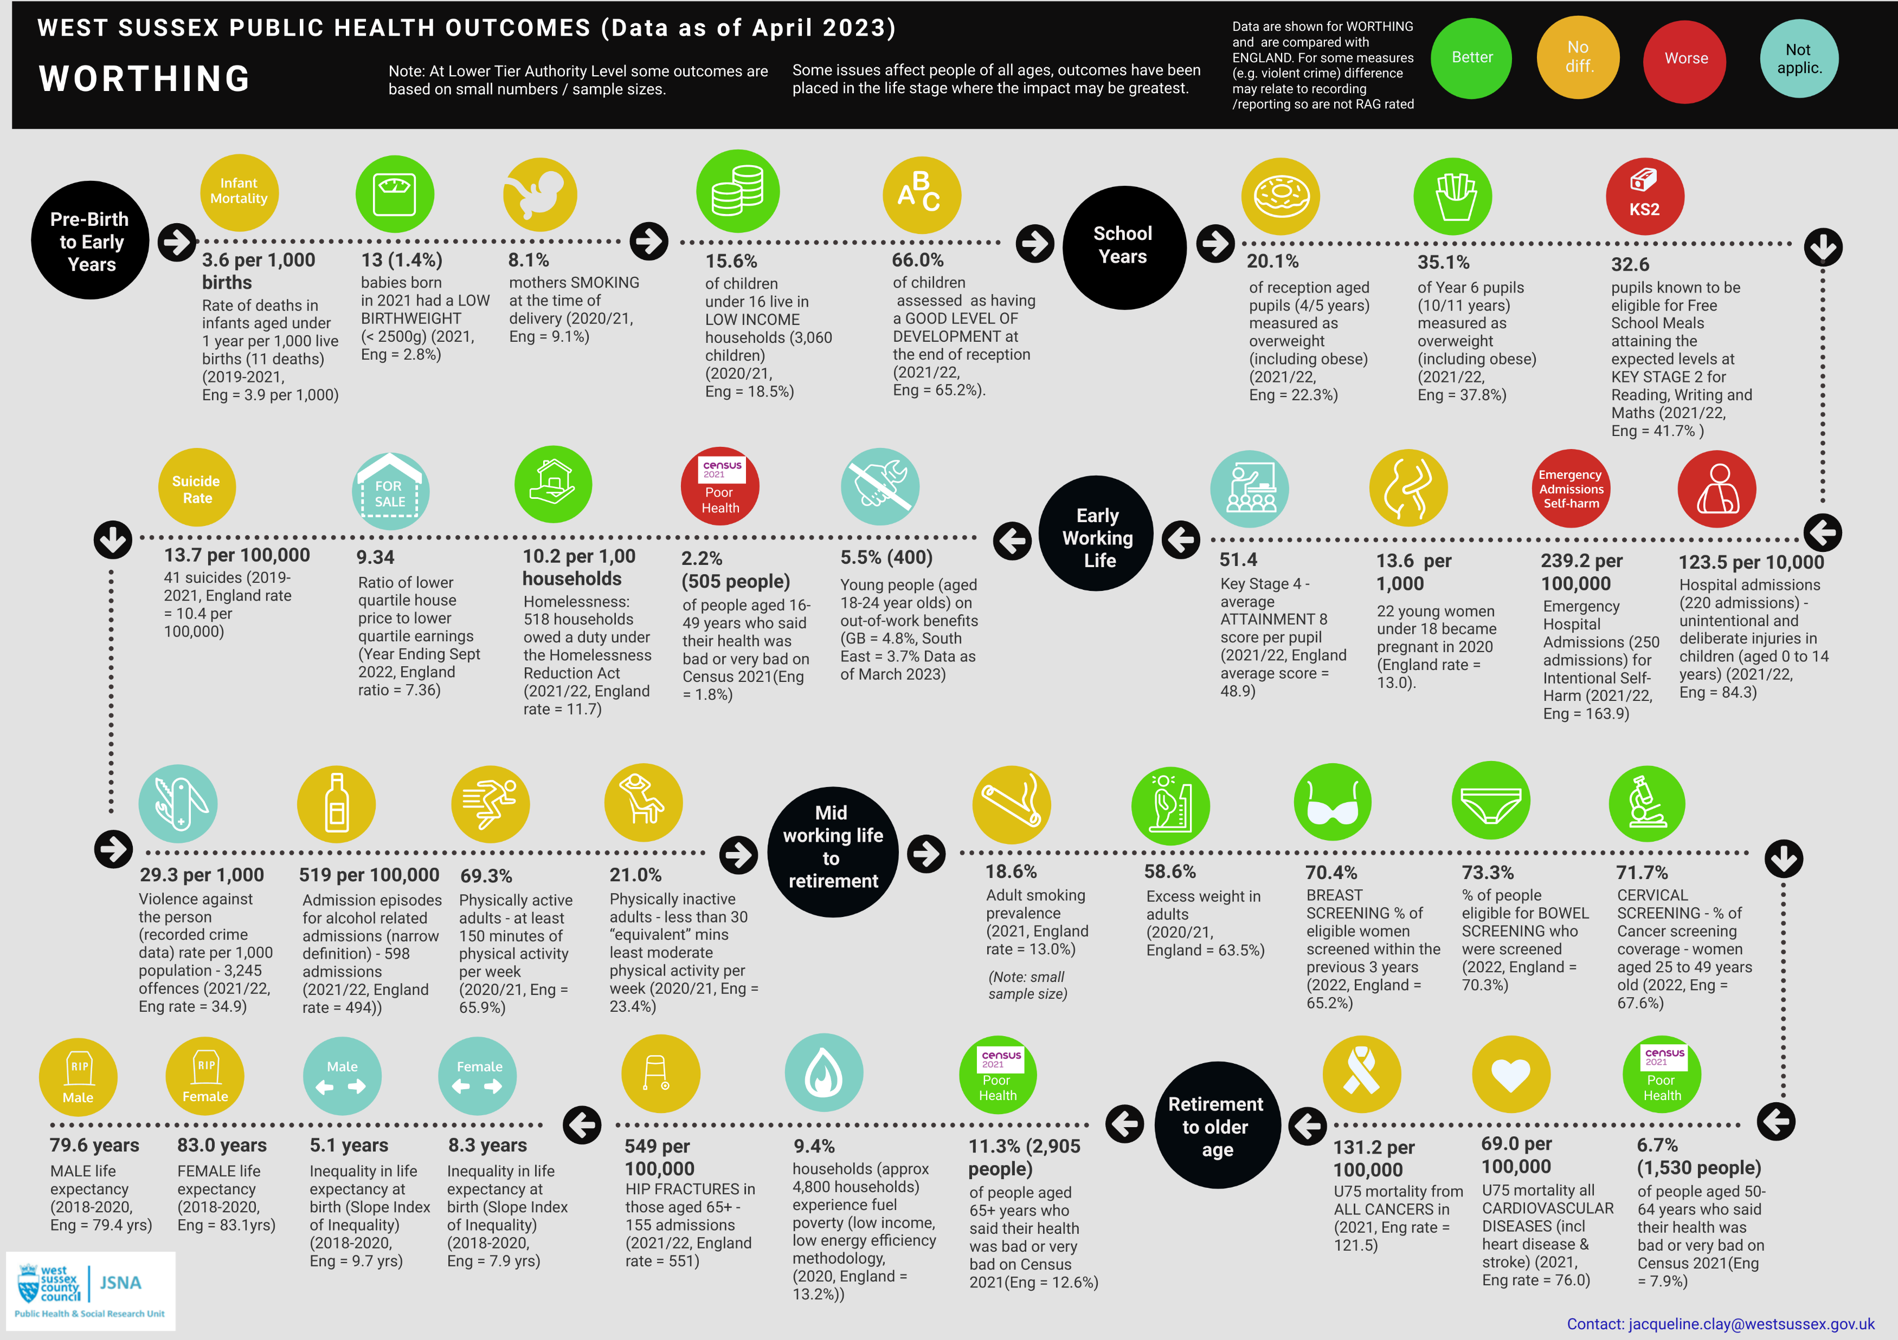

Slide 13
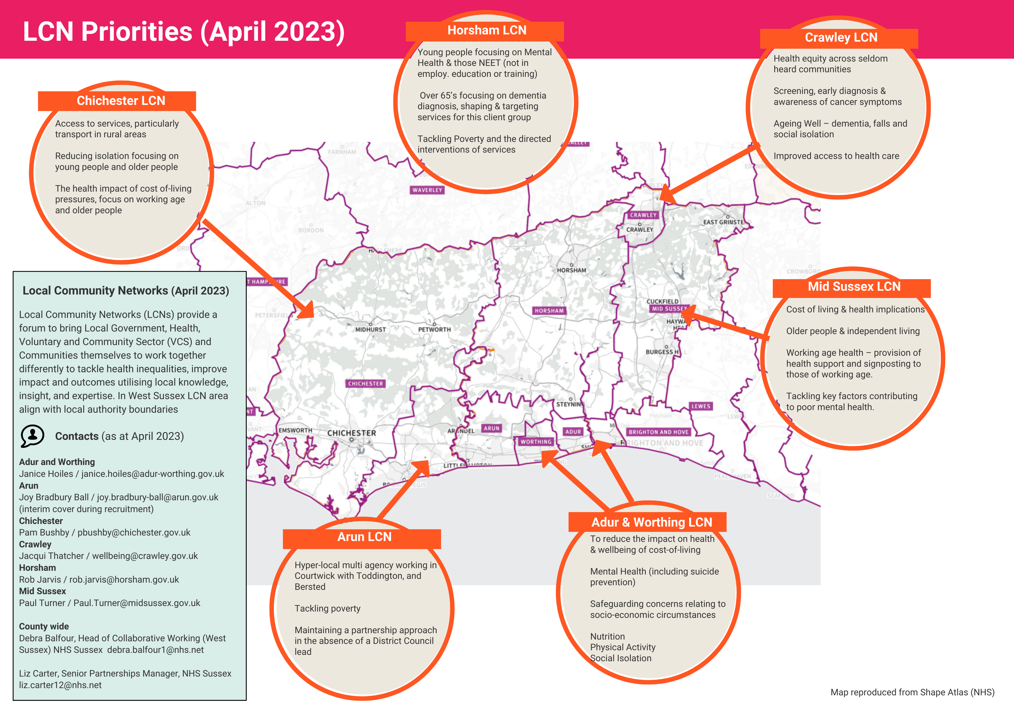

Slide 14
Using CoL data Summary
What are you trying to do about it
Understanding change, position of different groups
Local data for operational use and delivery
National data helpful to understand to short term changes in trends
Longer term lag on data

Slide 15
Framing Cost of Living Crisis
Cost of Living Crisis Impact on Health Using a Public Health Approach Jacqueline Clay. jacqueline.clay@westsussex.gov.uk
The cost of living crisis is affecting the basic building blocks of good health: disposable income, housing, food, transport.
A larger number of people are experiencing difficulties, but some people are at higher risk – and many of these are the same people disproportionately affected by the COVID-19 pandemic and the austerity before that.
The cost of living crisis affects health in many ways but I will concentrate on the basic driver of income and an increasing number of the population experiencing chronic stress (this is one way of looking at it!).
Scale is great, getting worse and is building on previous crises. Health outcomes should be at the heart of levelling up, rebuilding services and post pandemic recovery

Slide 16




Cost of Living Prevent, Mitigate, Adapt and Treat Example (yes they overlap!) Overarching rule in this is low income/poverty
Prevent
Mitigate
Adapt
Treat
What are we trying to achieve?
Maximise disposable income (raise income and or reduce costs)
Temporary support to reduce impact of specific events
Develop individual and/or community responses, change behaviour
Increase & target health programmes to reduce impact - e.g. population level chronic stress
Localised short / medium subsidy
Reduce school associated costs (uniform, meals, transport)
Reduce period poverty
Short term emergency loans and grants
Improve speed of new claimant applications and payments
Increase advice and guidance, access to financial services and products (e.g. credit unions)
Community approaches to sharing / renting goods.
Bulk buying of goods which reduce costs (microwaves, electric blankets)
Quality of food (move to nutrition focus)
Support to get people back into work
Maximise welfare benefits, identify possible underclaiming of core benefits amongst older and disabled claimant group
Reduce smoking levels and costs
Increase awareness of symptoms of chronic stress and population level messages
Expansion of Diabetes Prevention Programmes
Smoking reduction
HEAs of healthcare provision
Possible interventions for the short term
Move - reduce costs, realise asset wealth (such as downsizing)
(with mitigate) shift to cheaper fuel options.
Shift in patterns of work to reduce costs
Public housing for rent at affordable levels
Living wage employment by Anchor Institutions
Improve education and skills, and pay levels amongst resident population
Longer term investment in transport.
Smokefree West Sussex
Increase investment into activity and neighbourhoods, Local Plan
Possible interventions for the medium to long term
Understanding background context……

Slide 17

Example – Building Blocks for Health – focus on income (and disposable income)
Increasing number of people affected by one or more….
Food and water
Struggling to keep up….the just managing, keeping your head above water, perhaps room to to adapt spending
Housing
Income
Health impact….
Employment
Catastrophic events… and reducing in value from car or boiler breaking down, to needing a dentist to buying new shoes.
Transport
For example….Chronic Stress increasing in the population, affecting more people for a longer period of time
Education
Family and social networks
Free from discrimination and prejudice
Increasing Debt (and negative incomes)….increasing number of people may not have income to meet basic building blocks (food, water housing, fuel) – root cause problem lack of money, little ability to adapt
Leisure, creativity
Social capital - bonding, bridging, linking
Health care services
Poorest groups / low paid workers / most deprived neighbourhoods
Disabled / those with long term health conditions
Children
Women (proxy for unpaid caring burden)
Elderly (dependent on service recovering after austerity and social care improvement)

Slide 18
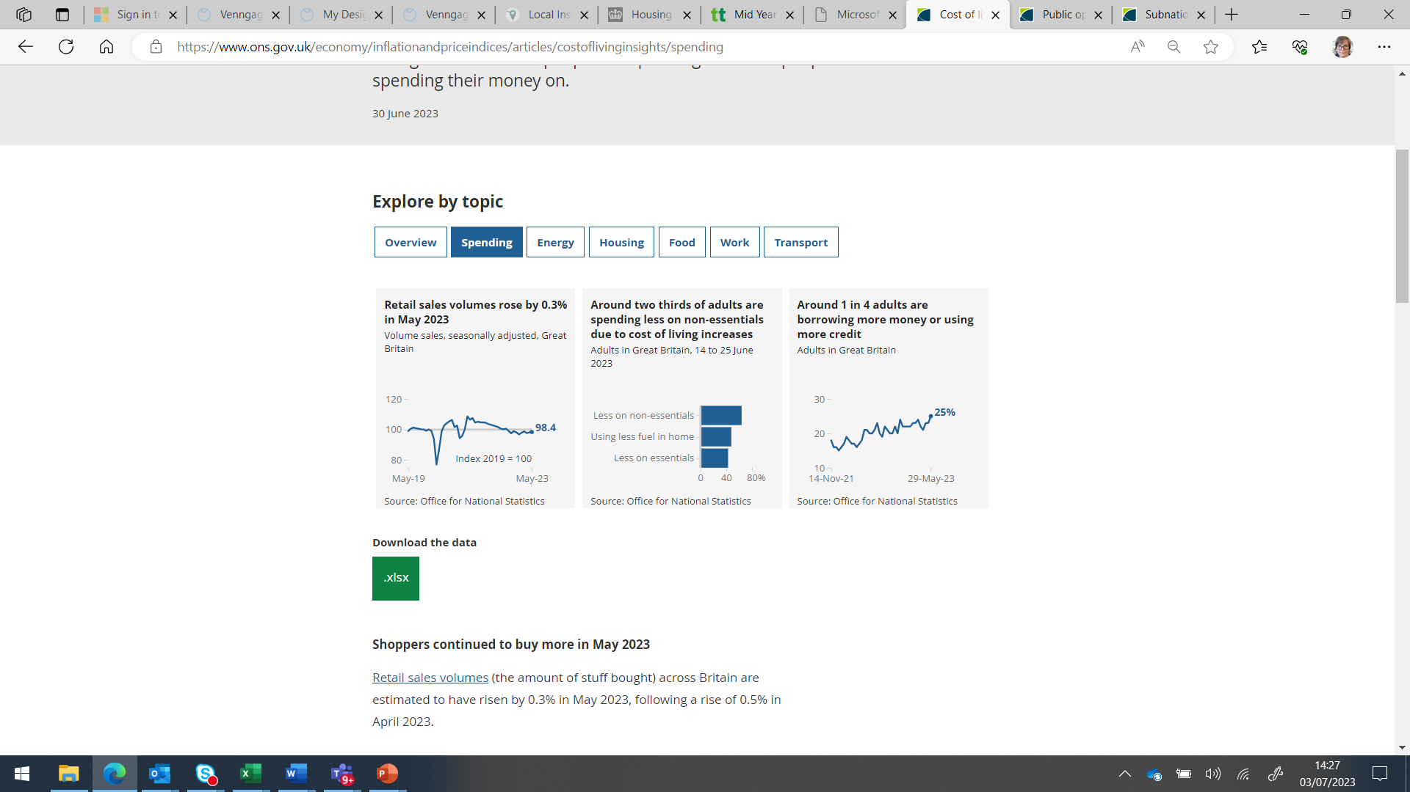
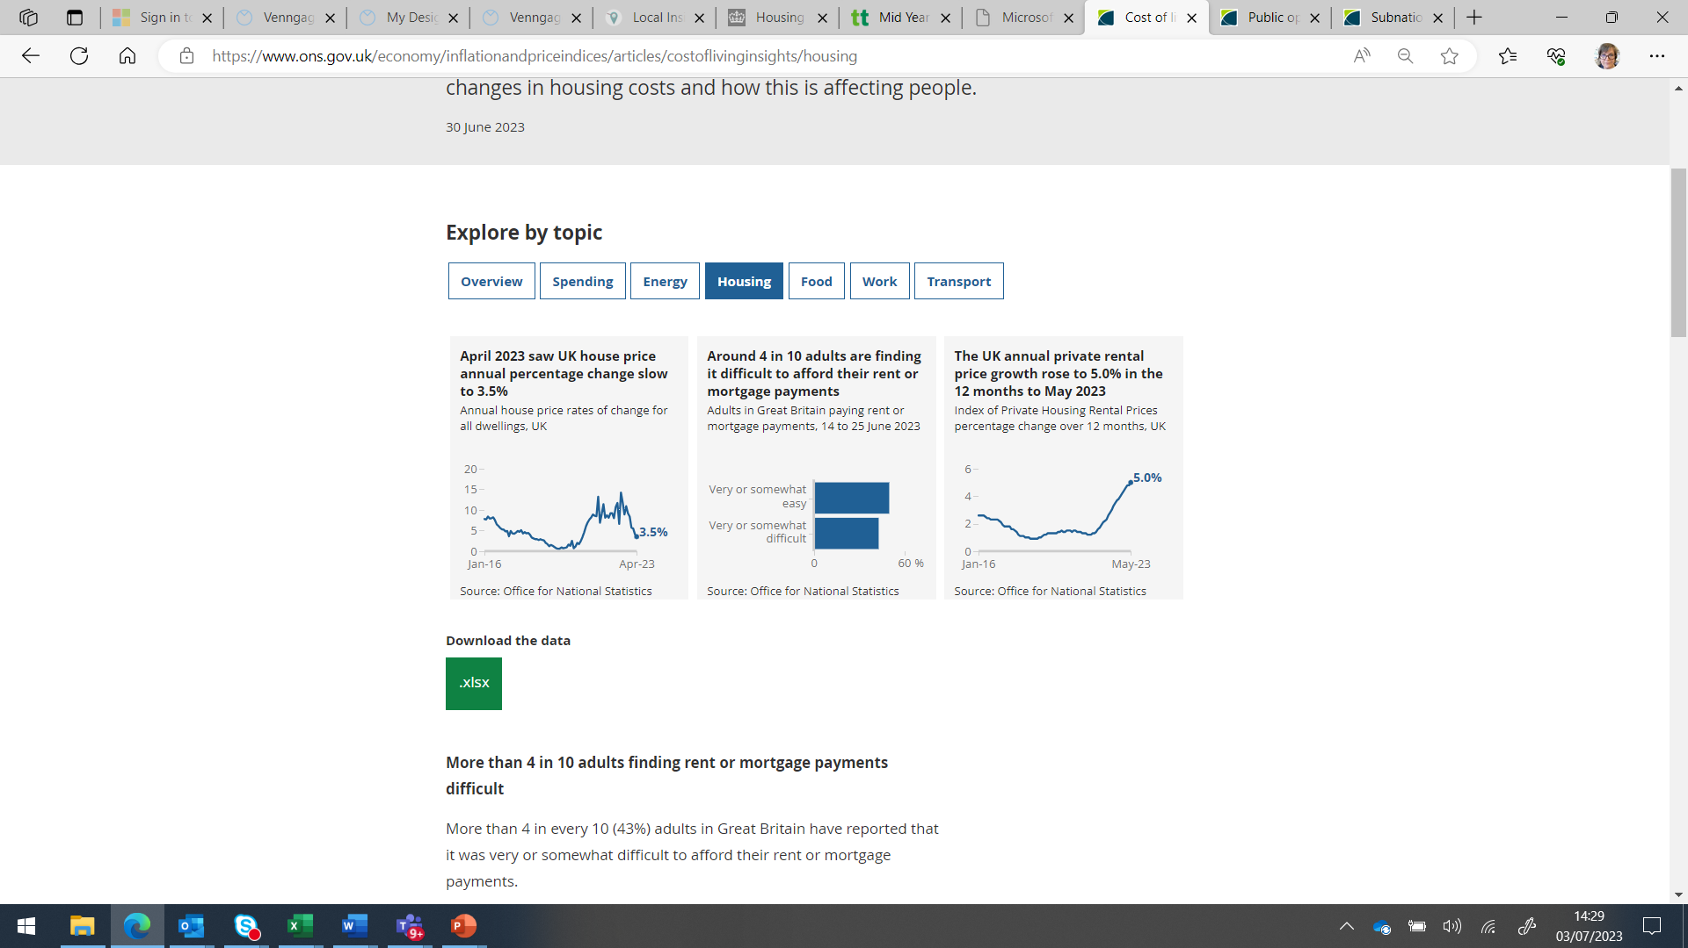
National Level – Data from Opinions and Lifestyle Survey (OPN)
Very quick turnaround of opinions (fortnightly and published within a week of collection
Approx 5,000 households nationally, data below - 14 to 25 June 2023
ONS releasing analysis of Feb – May 2023 in July 2023 (will identify issues for specific groups)
https://www.ons.gov.uk/economy/inflationandpriceindices/articles/costofliving/latestinsights

Slide 19
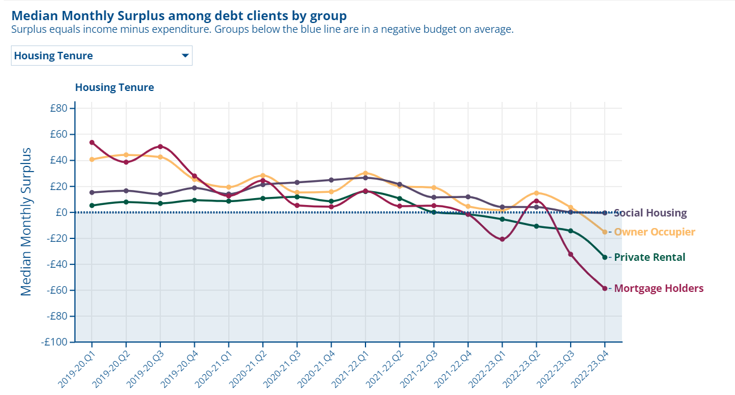
Citizens Advice – Data – National Useful to Understand what is Happening to groups
How is the cost of living crisis affecting different groups? | Flourish

Slide 20
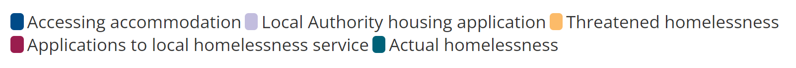
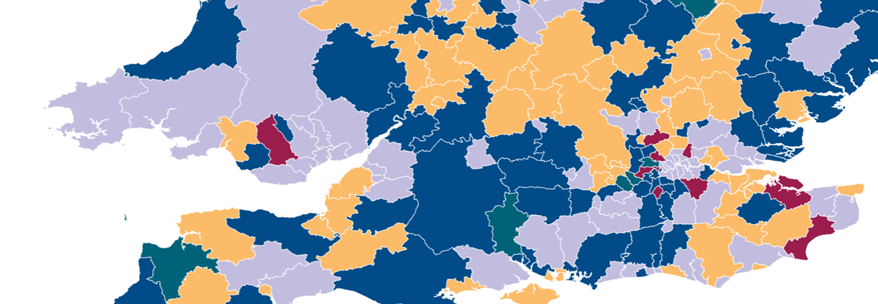
Citizens Advice – Data - at Lower Tier Level
e.g.
The most common types of housing issues we help people with by local authority
How does the cost of living crisis differ between local areas? | Flourish

Slide 21
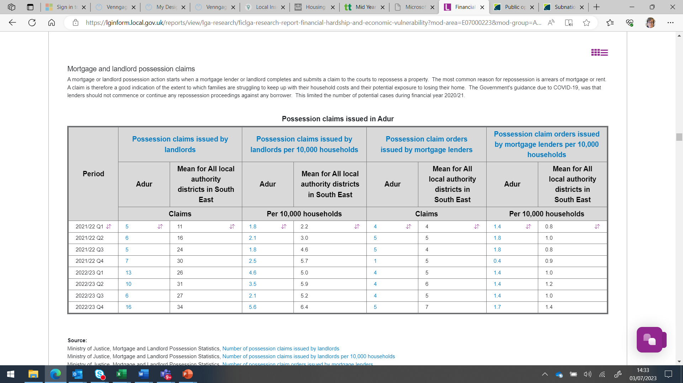
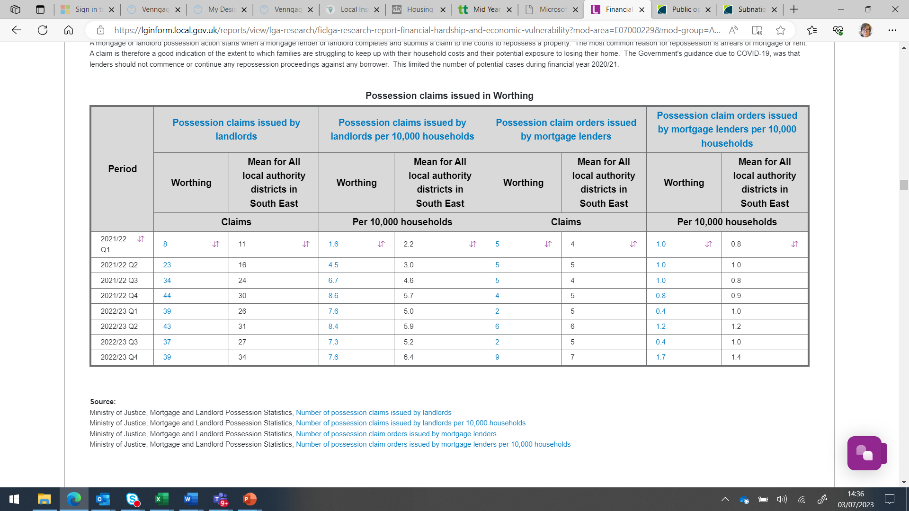
Identifying Shifts in Housing Problems – LGA Inform
Longer term lag into administrative data
Financial hardship and economic vulnerability in Peterborough | LG Inform (local.gov.uk)

Slide 22
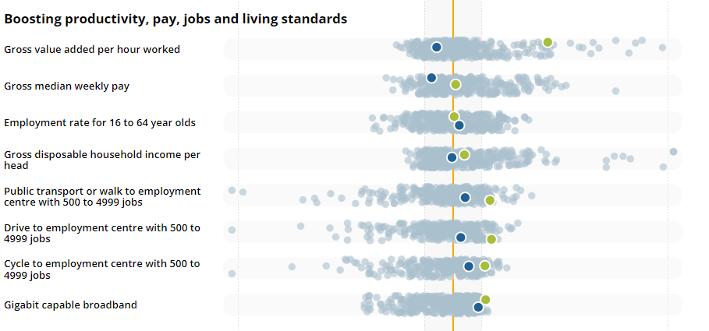
Cost of Living ONS Indicators – Adur & Worthing
Time lag on these high level datasets
https://www.ons.gov.uk/peoplepopulationandcommunity/wellbeing/articles/subnationalindicatorsexplorer/2022-01-06

Slide 23
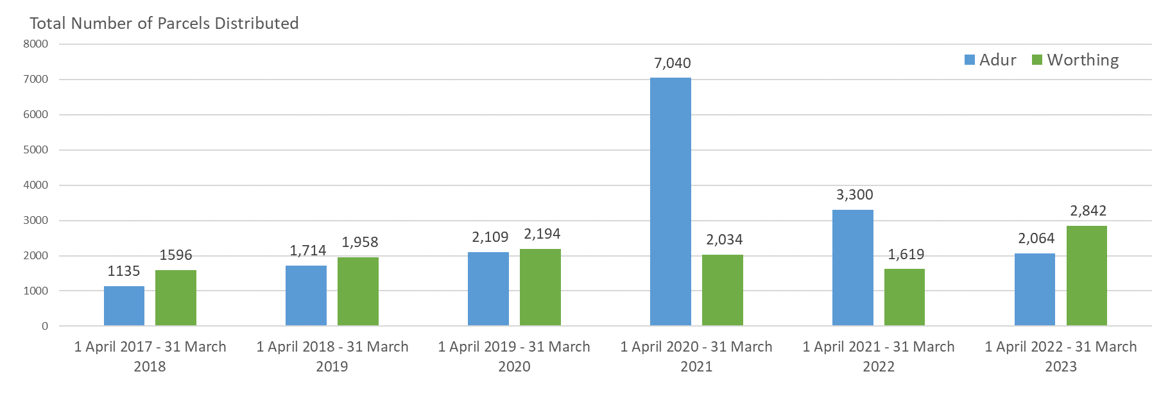
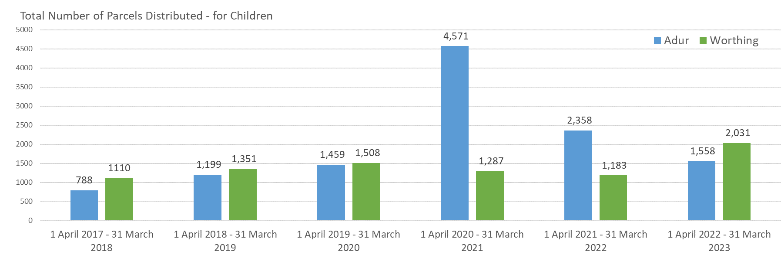
Trussell Trust Data (Annual) 2017/18 to 2022/23
Adur and Worthing
Trussell Trust state that data at the local level has been analysed based on the location from which the parcel was collected or delivered, rather than where the household receiving each parcel is living.

Slide 24
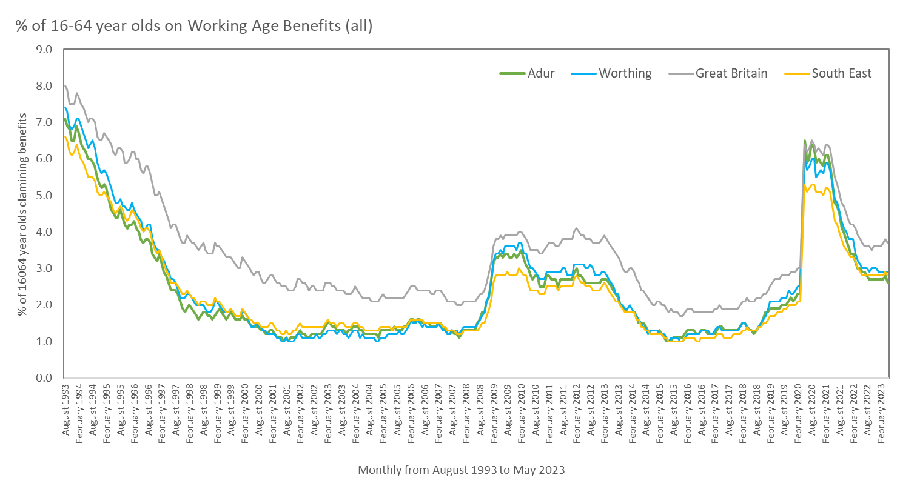
Working Age Claimant Rate – August 1993 to May 2023
Adur and Worthing, with GB and SE
Source: DWP – accessed via nomisweb.co.uk

Slide 25
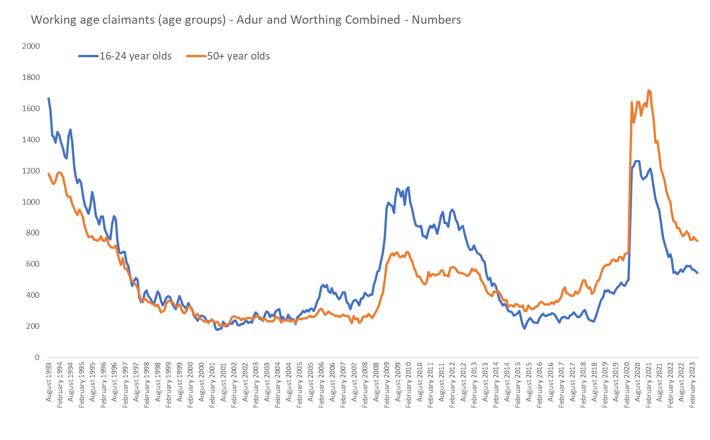
Numbers of Claimants (16-24 years and 50+ years)
August 1993 to May 2023 - Adur and Worthing
In May 2023 there were
Source: DWP – accessed via nomisweb.co.uk

Slide 26
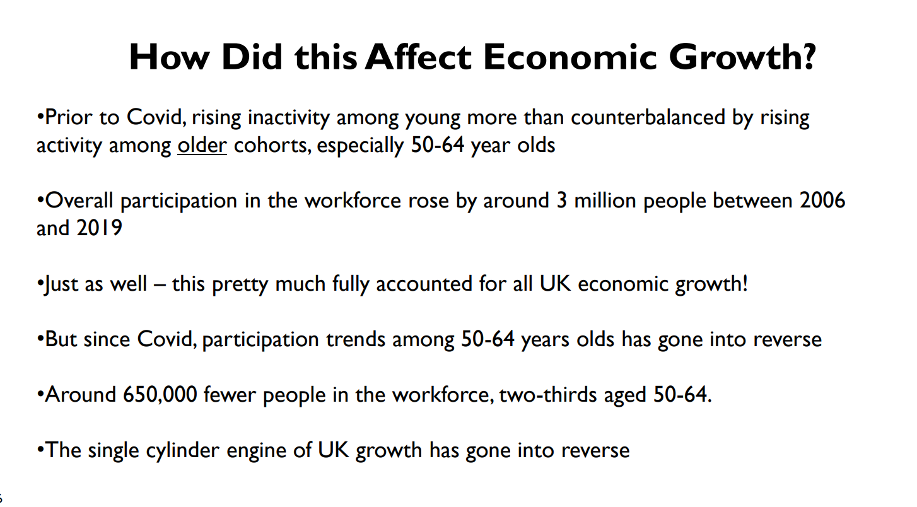
Implications of Older Workers – personal level and wider economic level
Slide taken from Health is Wealth lecture by Andy Haldane, CE of RSA, previously Chief Economist at BoE
https://www.health.org.uk/about-the-health-foundation/get-involved/events/health-is-wealth

Slide 27
Attendance Allowance
Non-means tested
65+ benefit people who have care needs (need support with daily living)
Based on need
Lower and higher rates – average £80 per week in Adur and Worthing.
 | May-18 | May-19 | May-20 | May-21 | May-22 | Nov-22
Adur | 1,811 | 1,771 | 1,787 | 1,743 | 1,767 | 1,812
Arun | 5,463 | 5,511 | 5,536 | 5,396 | 5,321 | 5,476
Chichester | 3,291 | 3,365 | 3,347 | 3,299 | 3,272 | 3,347
Crawley | 1,952 | 1,965 | 1,899 | 1,841 | 1,820 | 1,820
Horsham | 3,064 | 3,216 | 3,191 | 3,149 | 3,162 | 3,197
Mid Sussex | 3,071 | 3,103 | 3,055 | 2,940 | 2,906 | 2,917
Worthing | 3,027 | 3,036 | 2,969 | 2,885 | 2,892 | 2,961
Census 2021 – People Aged 65+ - Disabled
Row Labels | Disabled under the Equality Act
Adur | 5,318
Worthing | 8,795
Grand Total | 14,113
"Do you have any physical or mental health conditions or illnesses lasting or expected to last 12 months or more?". If they answered yes, a further question "Do any of your conditions or illnesses reduce your ability to carry out day-to-day activities?"

